Slide 1
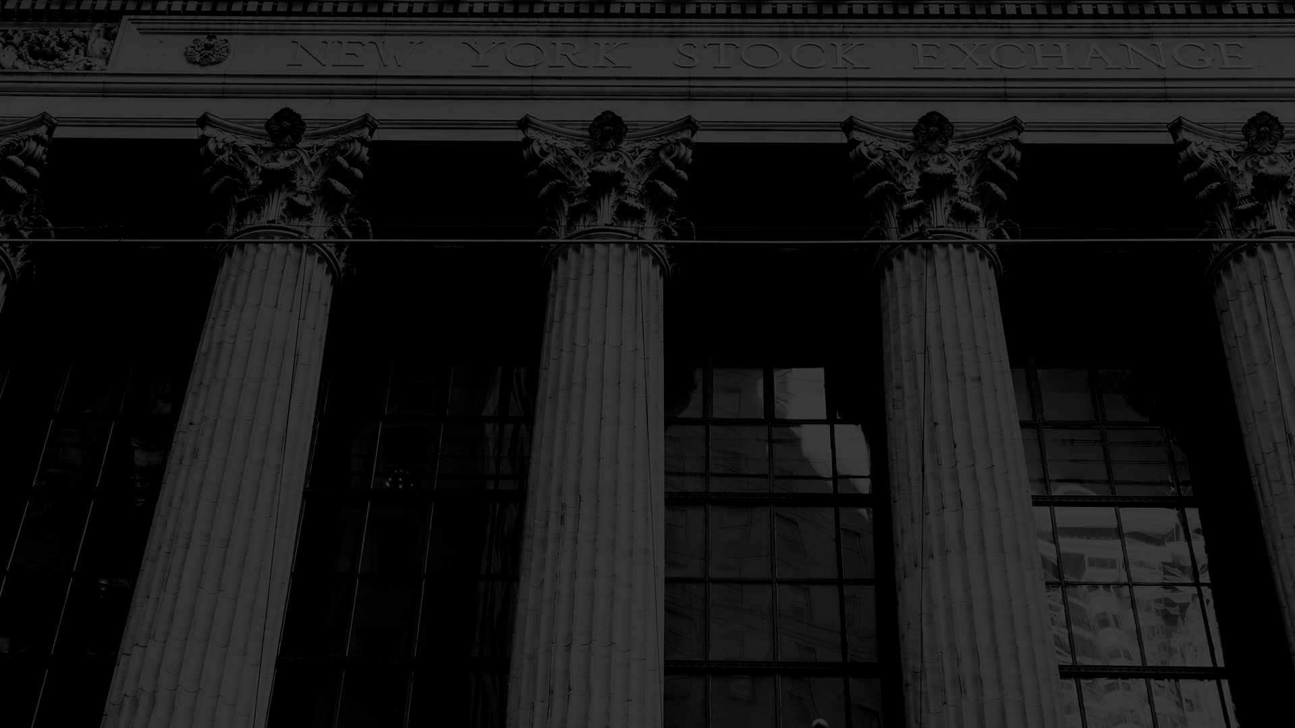
Peaceful Paradise
Project presentation

Slide 2
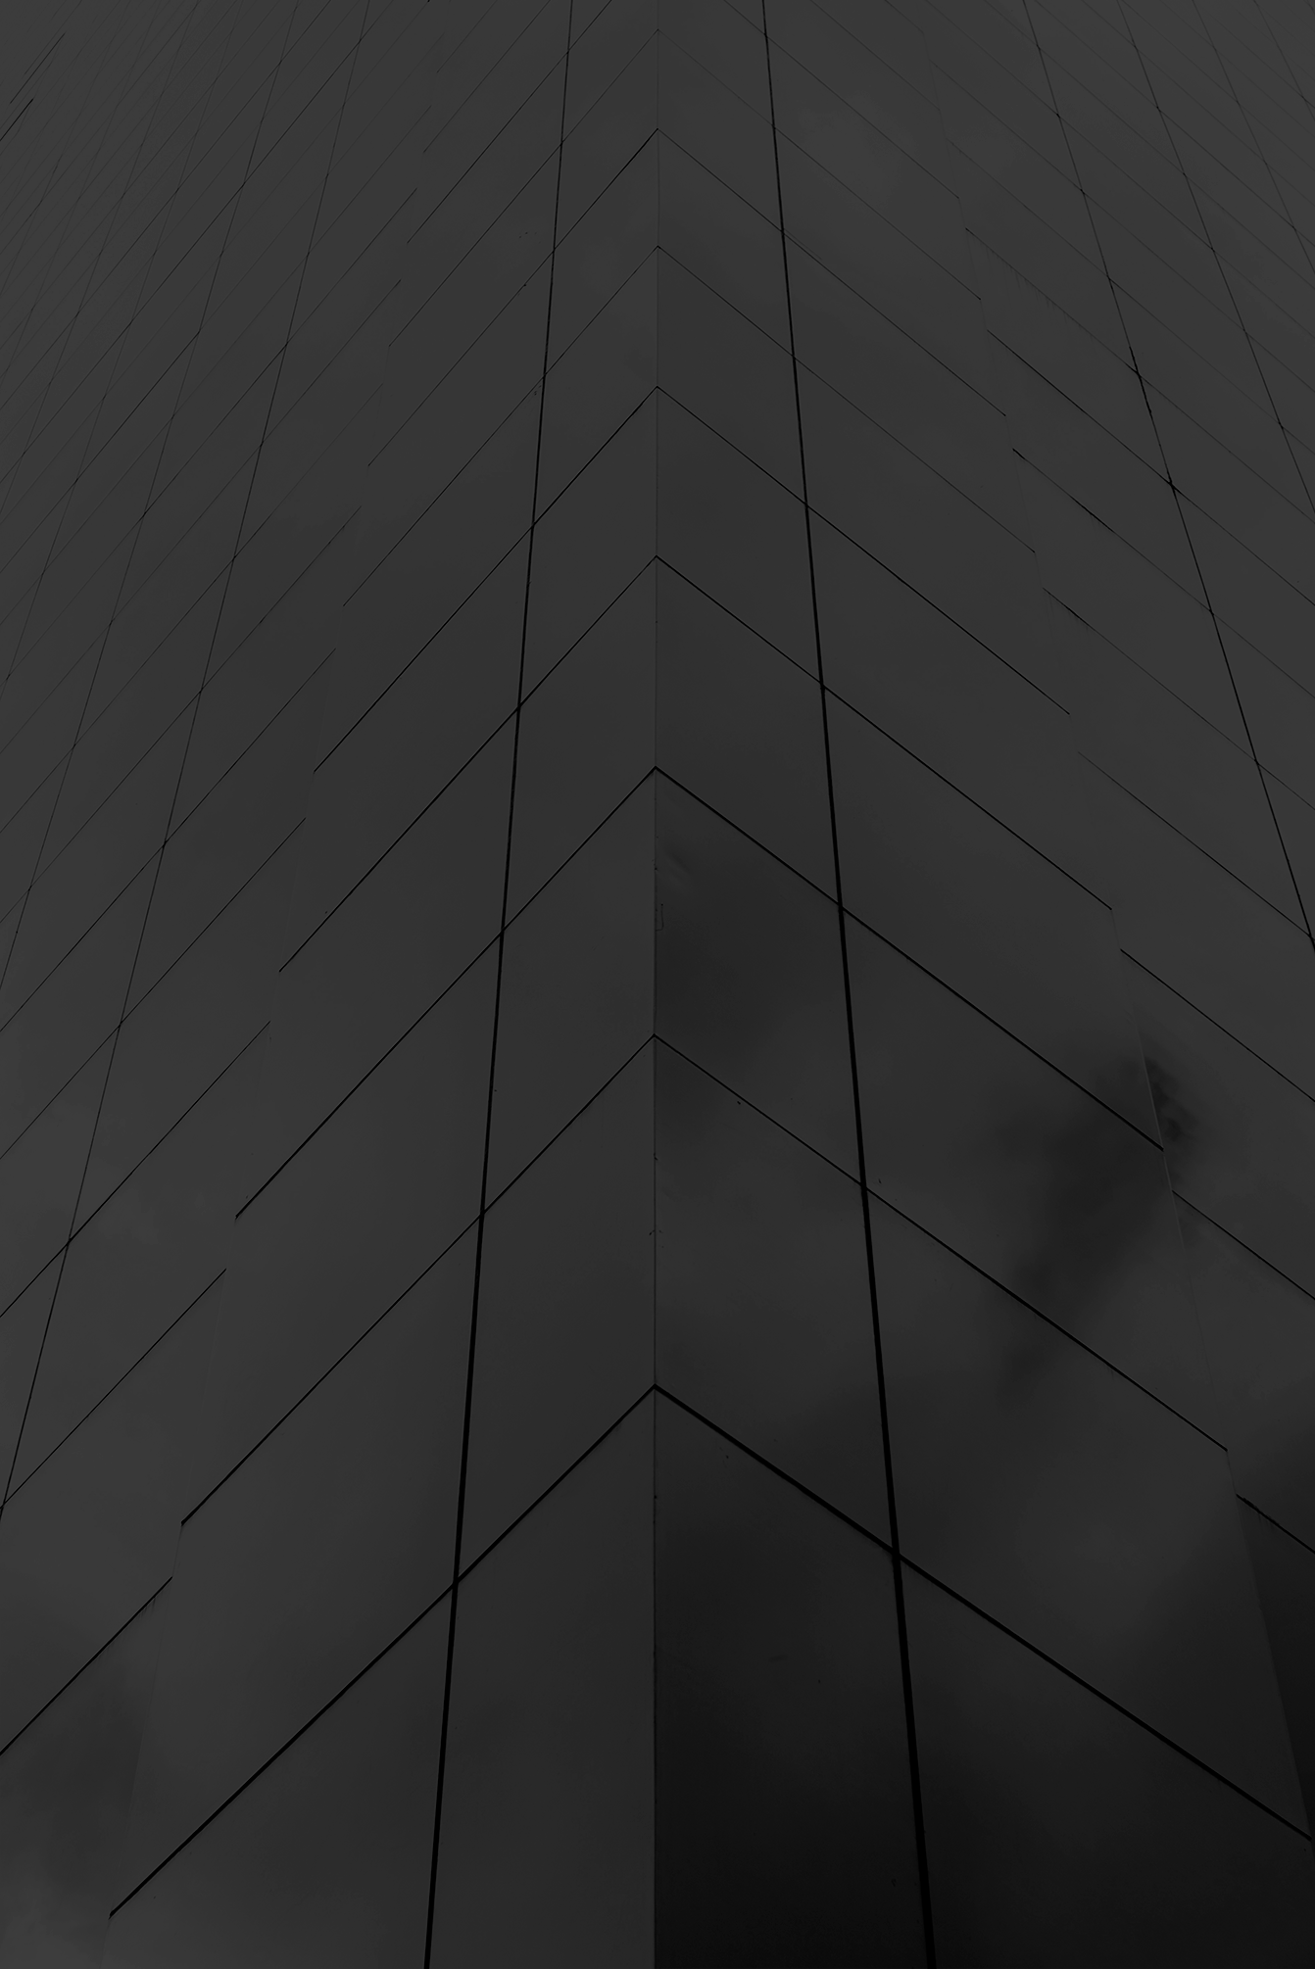

The Idea
Our logo
Hotel website
Reservation algorithm
Reception application

Slide 3

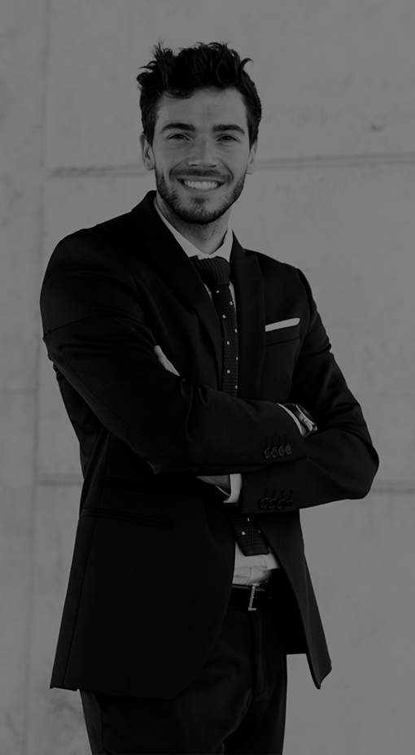
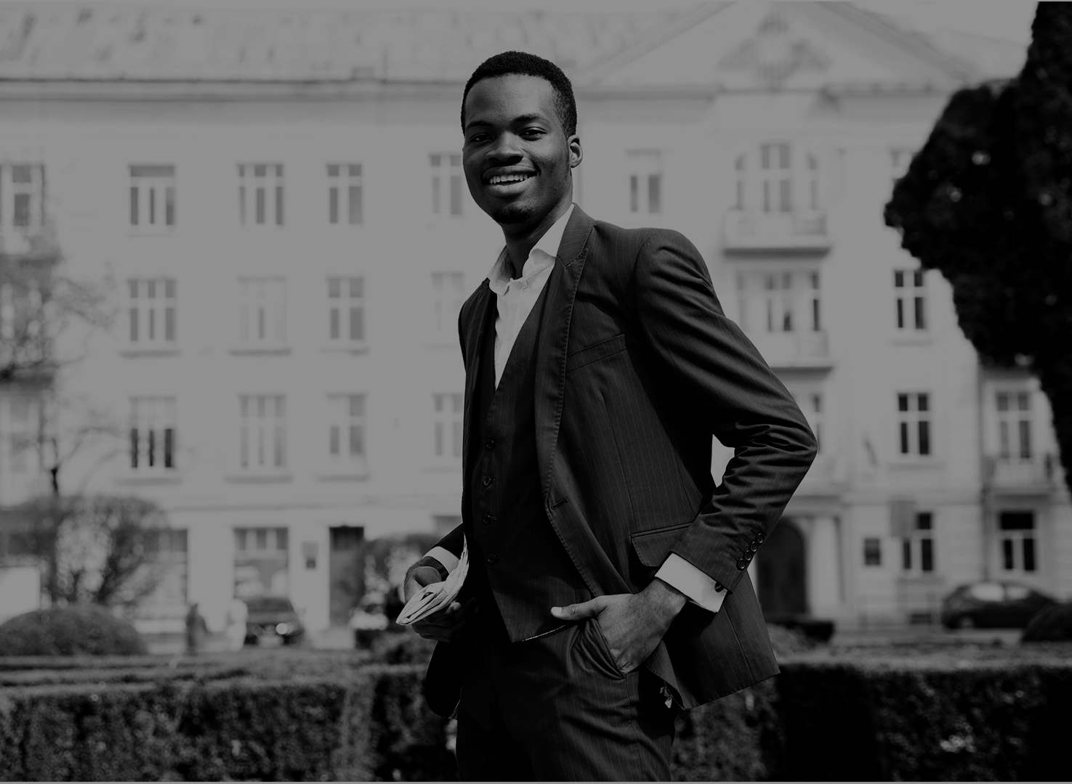
Our Team
Gábor Roncz
Reservation System
API Requests
Dávid Kálmán
Kornél Vass
Design
Sign-in, Email
Reception App
Database

Slide 4
Our Process
Step 1
Step 2
Step 3
Step 4
Step 5
Search a free room by your needs
Select the type of the room
Pick a service type
Provide your personal data
Finalize the reservation

Slide 5




Our discount system
Gold
Platinum
Diamond
3 reservations
5% discount
6 reservations
10% discount
9 reservations
15% discount

Slide 6
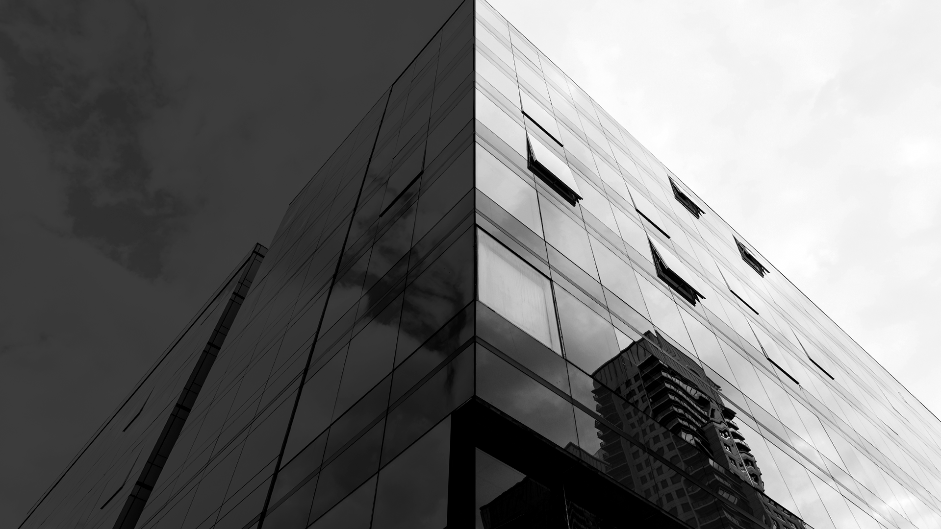
Login
Registration
Email or username
Password
Forgot password
Name
Email
Password
Confirmation

Slide 7
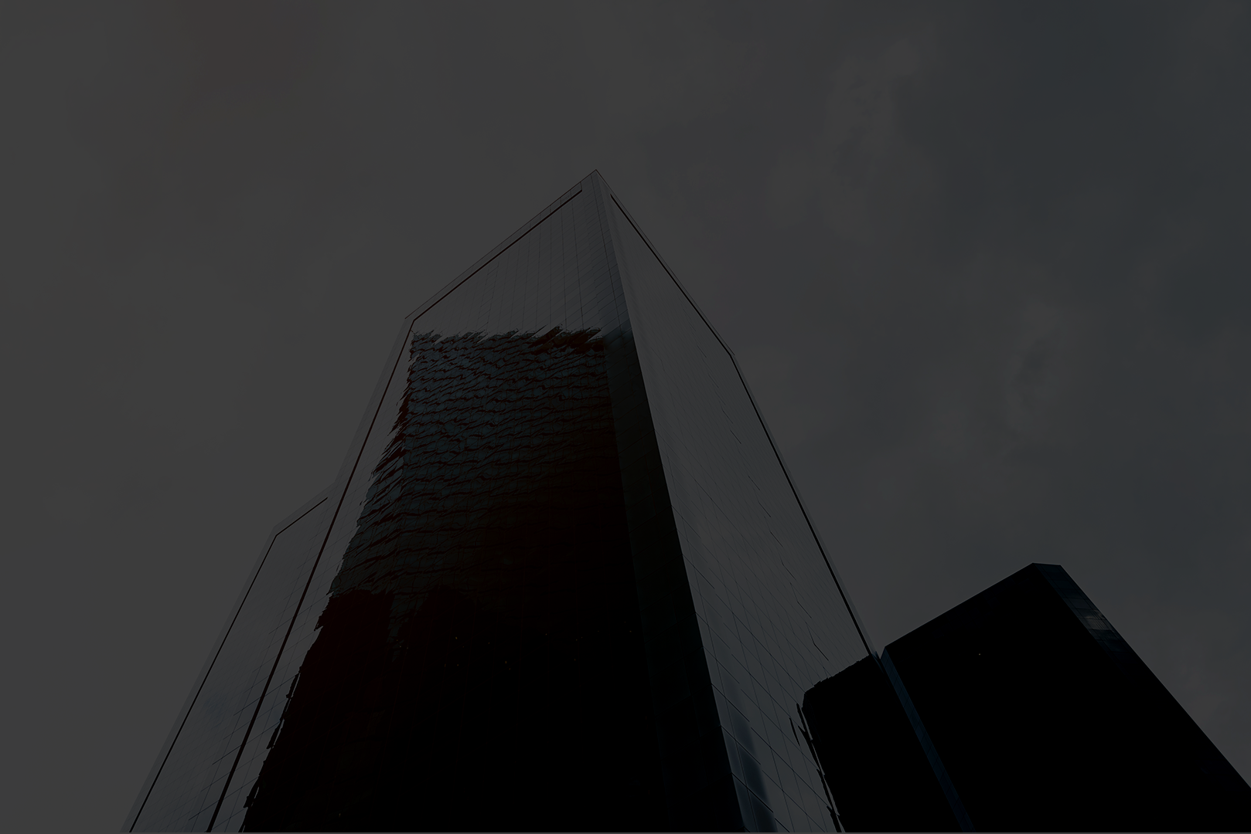
Email sending
At
Registration
Password recovery
Changing email address
Confirming a reservation
Contacting us

Slide 8

Check-in
Check-out
Select a client
Validate their data
Arrange payment
Select a guest
Review their check-out date
Check their consumptions
Discuss remaining costs

Slide 9
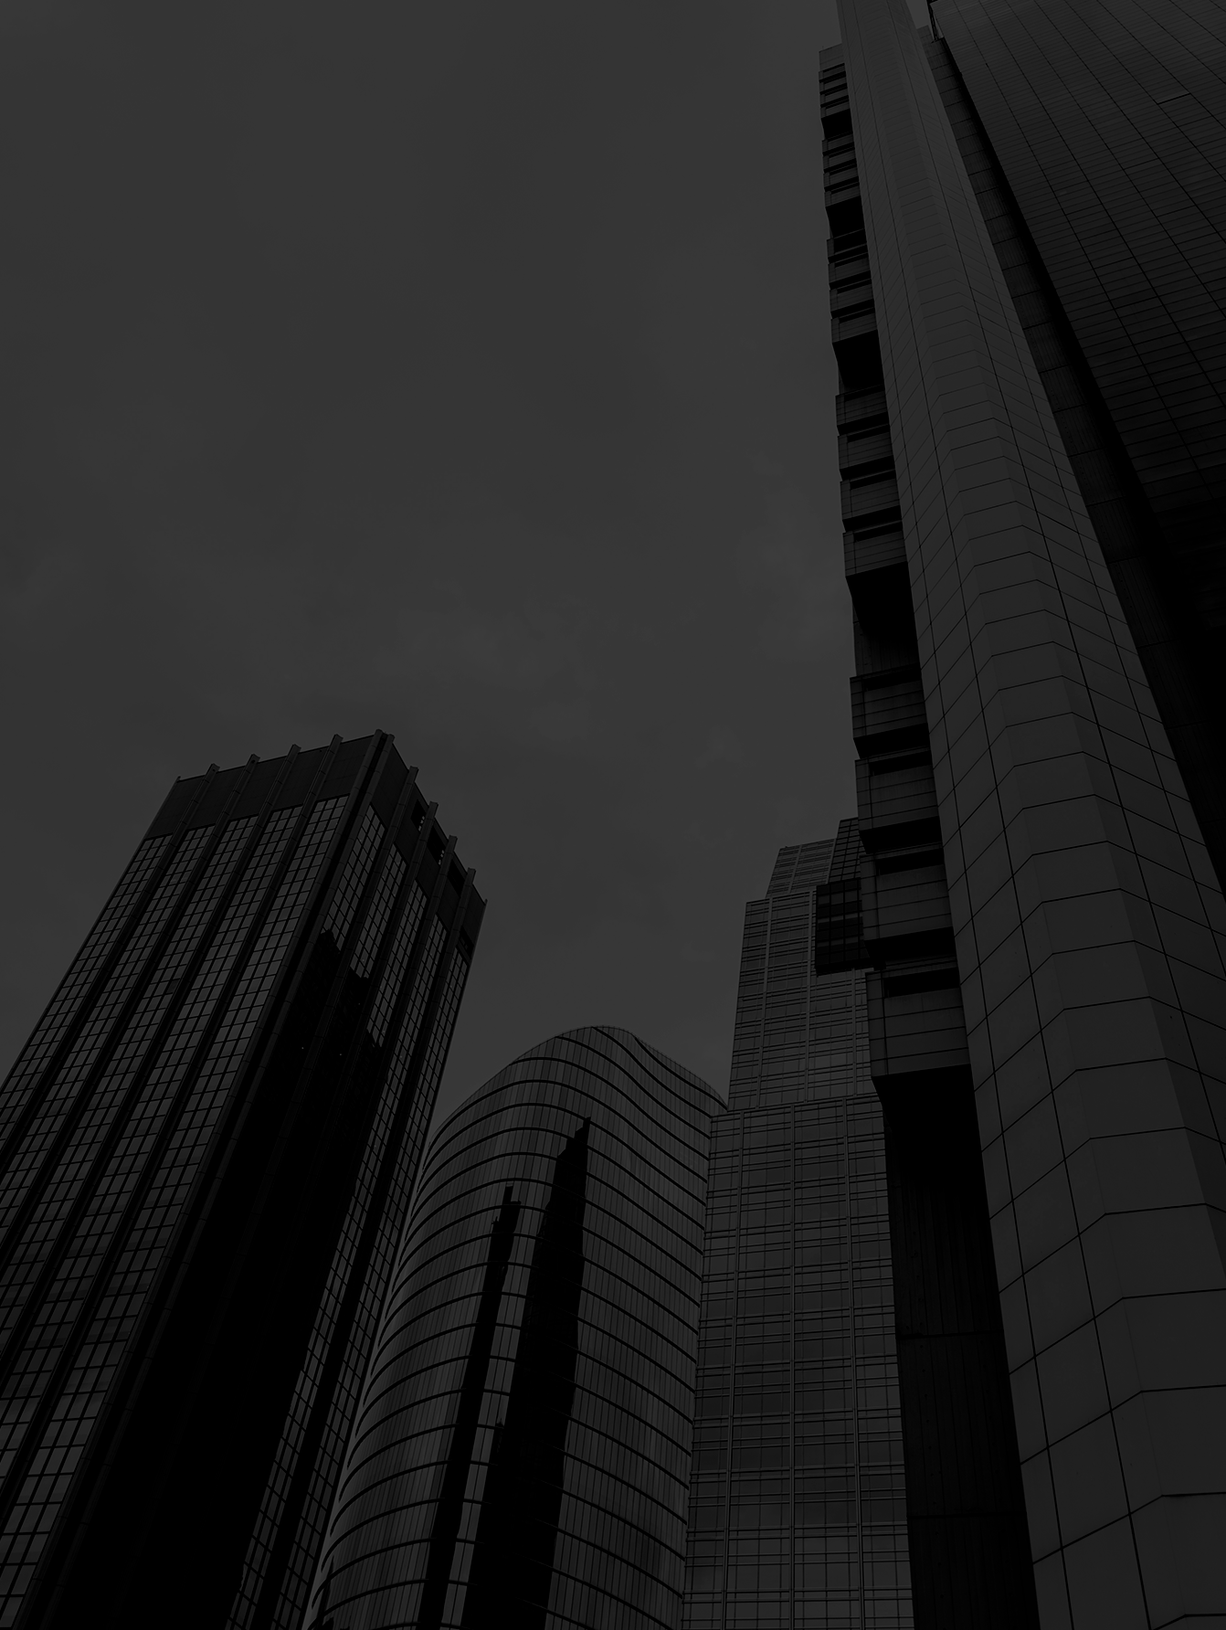
Advertising and Promotion
Consumptions
Inspect logs
Check messages
Assign elements to different reservations
Create new items
User logs
Reservation logs
Respond to reports
Read ratings

Slide 10
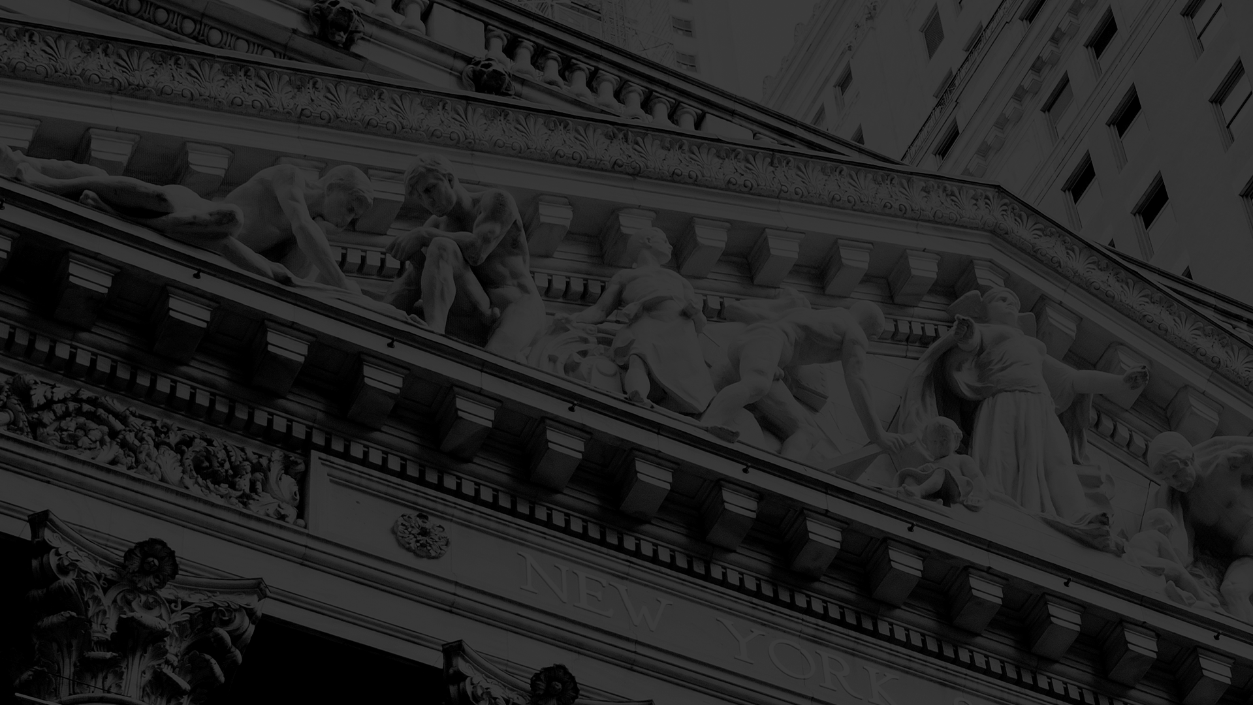
Thank you for your time!
Made by:
Dávid Kálmán
Gábor Roncz
Kornél Vass

Slide 11
...and our sets of editable icons
You can resize these icons without losing quality.
You can change the stroke and fill color; just select the icon and click on the paint bucket/pen.
In Google Slides, you can also use Flaticon’s extension, allowing you to customize and add even more icons.

Slide 12
Educational Icons
Medical Icons

Slide 13
Business Icons
Teamwork Icons

Slide 14
Help & Support Icons
Avatar Icons

Slide 15
Creative Process Icons
Performing Arts Icons

Slide 16
Nature Icons

Slide 17
SEO & Marketing Icons

